Slide 1
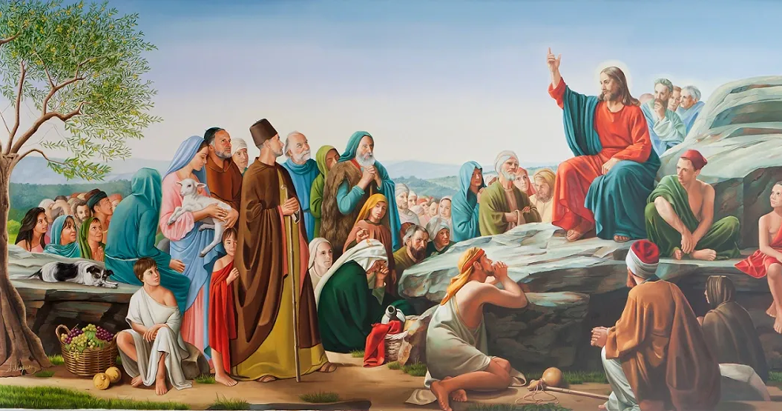
The Journey of Jesus
to the Cross (2)
The Message of Jesus: Blessing
Matthew 5:1-12

Slide 2
“The Beatitudes embody radical hope in a world of division and despair. Living a life of Beatitude means being in sync with the reign of God. The Beatitudes represent the ninefold path of Jesus and serve as a means of developing spiritual character. The Beatitudes are a journey into life in Christ and the pursuit of happiness in God’s way. Ultimately, they offer a way to live out the heart of Christ.”

Slide 3
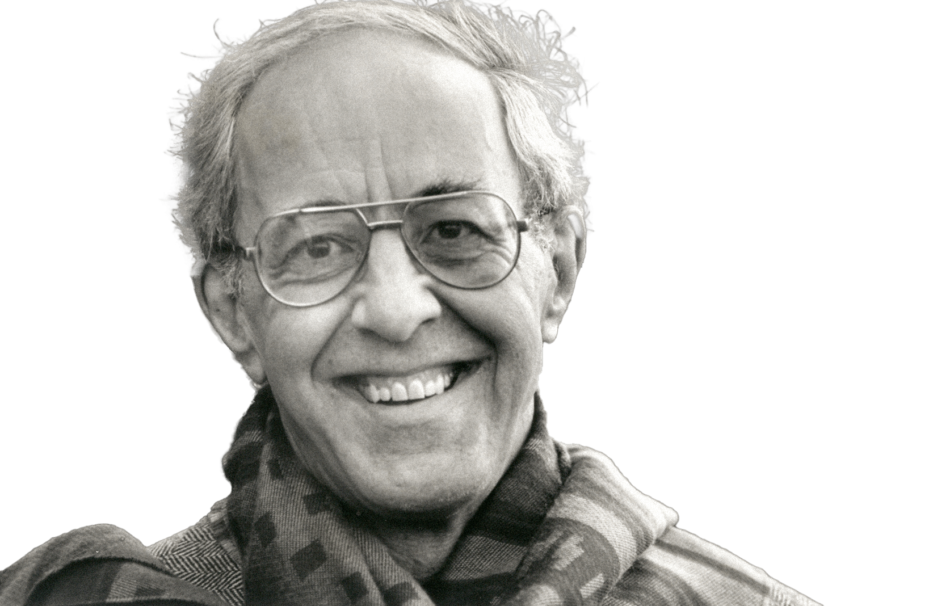
“Living the Beatitudes is… living as the chosen people of God. We can walk through our violent and fear-filled world with heads erect, confident that God is our guide and will fulfill the deepest desires of our hearts.”
Henri Nouwen,
Living the Beatitudes (1995), 6.
Henri Nouwen (1932-1996)

Slide 4
“Blessed are the poor in spirit, for theirs is the kingdom of heaven. Blessed are those who mourn, for they will be comforted. Blessed are the meek, for they will inherit the earth. Blessed are those who hunger

Slide 5
and thirst for righteousness, for they will be filled. Blessed are the merciful, for they will receive mercy. Blessed are the pure in heart, for they will see God. Blessed are the peacemakers, for they will

Slide 6
be called children of God. Blessed are those who are persecuted for the sake of righteousness, for theirs is the kingdom of heaven. Blessed are you when people revile you and persecute you and utter all

Slide 7
kinds of evil against you falsely on my account. Rejoice and be glad, for your reward is great in heaven.”
Matthew 5:3-12 NRSV

Slide 8
“makarios (μακάριος),”
“Blessed” or “deeply and extremely happy”
“beatus” (beatitude)
Latin translation of the Greek, “makarios”

Slide 9
“for theirs is the kingdom of heaven …
for they will be comforted …
for they will inherit the earth …
for they will be filled …
for they will receive mercy …
for they will see God …
for they will be called children of God …
for theirs is the kingdom of heaven …
for your reward is great in heaven.”
Matthew 5:3-12 NRSV
The Kingdom of
God

Slide 10
The poor in spirit
Those who mourn
The meek
Those who hunger and thirst for righteousness
The merciful
The pure in heart
The peacemakers
Those who are persecuted for the sake of righteousness

Slide 11
“Those who are literally poor and spiritually bankrupt and at a loss, you are blessed because you are welcomed to enjoy the richness of God’s Kingdom through Jesus. Those who cry and suffer in pain, you are blessed because Jesus

Slide 12
weeps and suffers together with you, leading you to his Kingdom. Those who are humble in a very challenging situation, you are blessed because, through Jesus Christ, you are the heirs of God’s Kingdom. Those who are waiting for God’s

Slide 13
Kingdom, your hope will be fulfilled through Jesus Christ. Those who show mercy towards others are blessed because Jesus Christ reveals his mercy to you and invites you to his kingdom. For those who have single-mindedness toward

Slide 14
God, Jesus is calling you to the Kingdom of Heaven to see God face-to-face in His presence. Those who remember their identity as God’s peace ambassadors, your names are recorded in the Book of Life as God’s children in His

Slide 15
Kingdom. Those who are in persecution because of Jesus Christ, know that you are remembered greatly in heaven now and forever. I invite you all to the Kingdom of God. It is not far from you. It is at hand because I am at hand.”

Slide 16
“Go therefore and make disciples of all nations, baptizing them in the name of the Father and of the Son and of the Holy Spirit and teaching them to obey everything that I have commanded you. And remember, I am with you always,
to the end of the age.”
Matthew 28:19-20 NIV

Slide 17
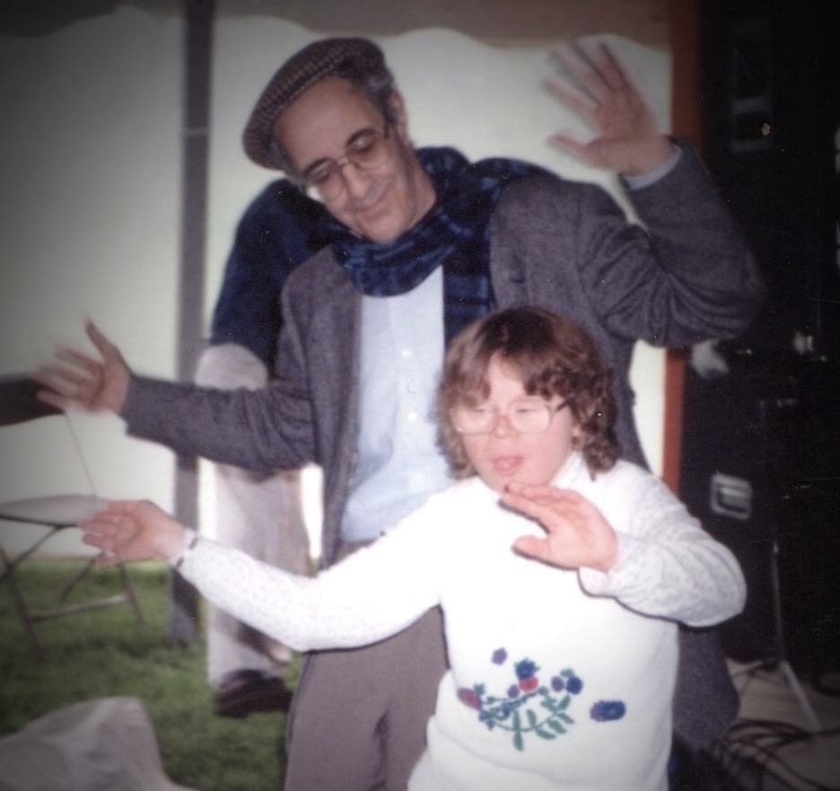
Nouwen at l’Arche Daybreak Community

Slide 18
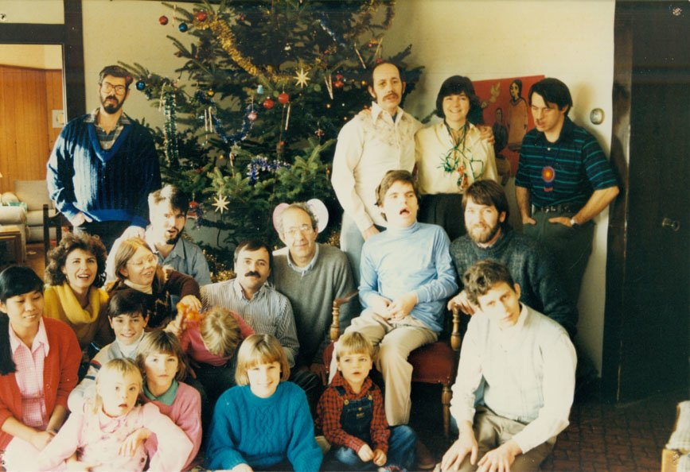

Slide 19
“L'Arche is not a service institution or a group home. It is a community that exists to reveal God's love. Our people are given to the world to tell others about peace and forgiveness and celebration, to make them aware that in the midst of their brokenness, there is joy; in the midst of their wounded nature, there is healing.”
Henri Nouwen

Slide 20
“He has brought down the powerful from their thrones and lifted up the lowly;
he has filled the hungry with good things and sent the rich away empty.”
Luke 1:52-53 NRSV

